Slide 1
CloudFront

Slide 2
Agenda
What CloudFront is?
Key terms in CloudFront.
How does CloudFront work?
Benefits of using CloudFront.
Demerits of using CloudFront.

Slide 3
CloudFront
Amazon Web Services Content Delivery Network (CDN).
Speed up file delivery.
AWS CDN.
Connects with other AWS services.
Businesses.

Slide 4
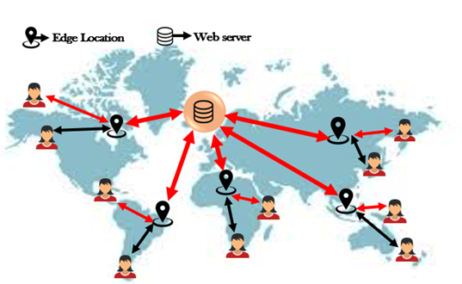
Key Terms
Edge location:
AWS data centers where data is cached.
Deliver access to the users.
Origin:
Source of all files that CDN will distribute.

Slide 5
Key Terms
Distribution:
Collection of edge locations is referred to as "distribution."
Creating a Distribution.
Web distribution.
RTMP.

Slide 6
How CloudFront works?
Nearest edge location.
It will pull the content from the S3 bucket.
The data will be pulled from the bucket.
The data is already cached in the edge location.

Slide 7

Advantages
Scalability:
Number of requests the files received.
No setup modifications required to respond to the rising load.
Serving static content for a website or a rapidly developing application.

Slide 8

Advantages
Easy setup:
Does not require any maintenance.
Developing your application's business logic.
Flexibility:
Serving.
Tailor or modify our CloudFront distributions to have different caching practices.

Slide 9
Disadvantages
CloudFront is a pay-per-use service.
Don't gain a lot of insight into Cloudfront's fundamental structure.
Have to pay extra.

